Slide 1
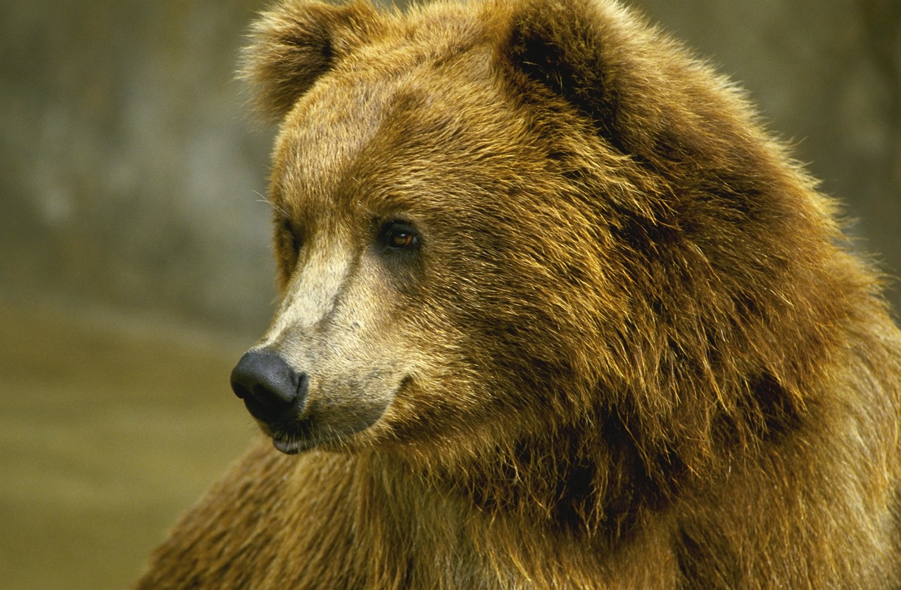
Bears

Slide 2
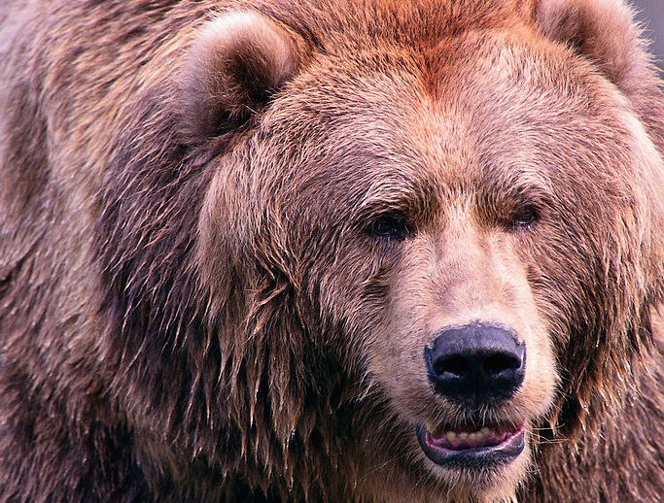
Where do they live?

Slide 3
What do they eat?

Slide 4
How big do they get?

Slide 5
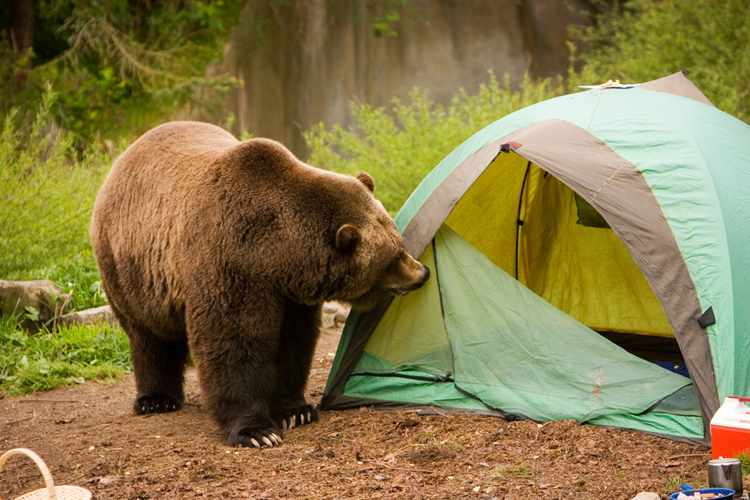
Are bears dangerous?

