Slide 1
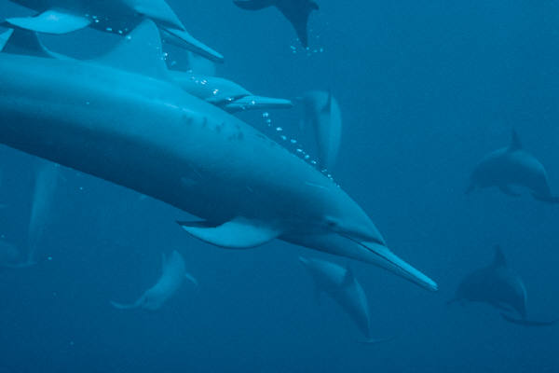
Bottlenose Dolphin

Slide 2
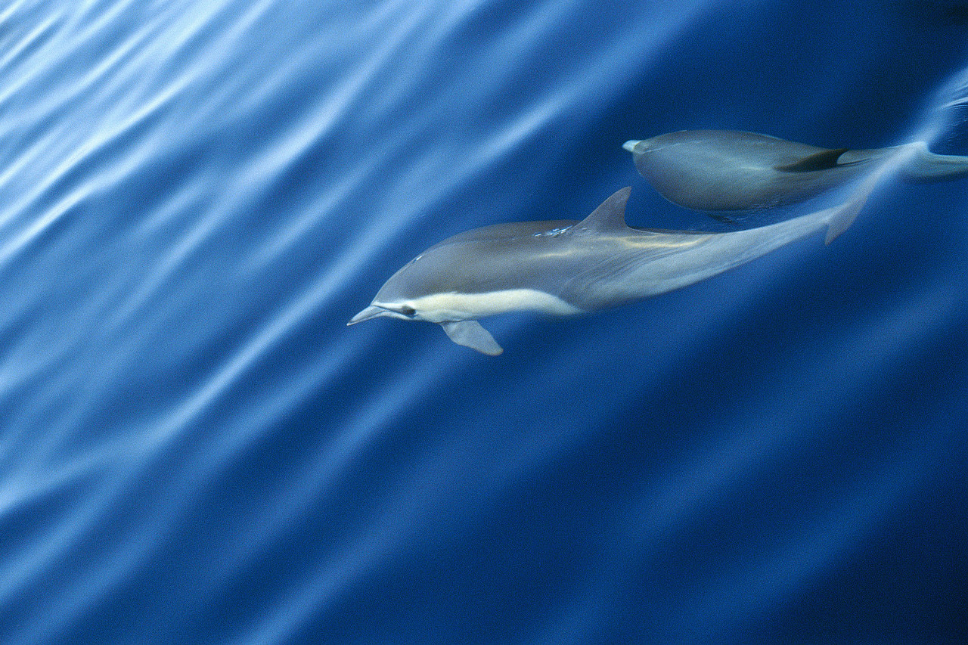
Where do they live?

Slide 3
How do they communicate?

Slide 4
What do they eat?

Slide 5
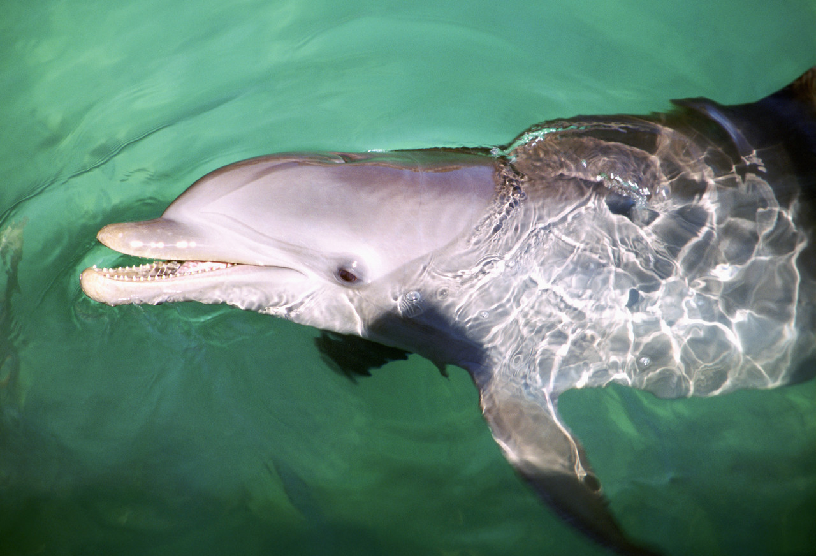
How smart are they?

